Slide 1







IBM Data Analyst Capstone Presentation
Martin Mroz
December 2nd, 2021

Slide 2



OUTLINE
Executive Summary
Introduction
Methodology
Results
Visualization – Charts
Dashboard
Discussion
Findings & Implications
Conclusion
Appendix

Slide 3

EXECUTIVE SUMMARY
Assessing the state of various programming language usage and database usage
Will also be assessing:
Platforms
Web Frames
Demographic information of respondents
Geographic distribution of programmers and language, database, etc… used
Gender differences in jobs

Slide 4

INTRODUCTION
The goal of this presentation is to assess and analyze trends in global software and web development
Specifically:
Determining current in-demand skills
Predict future in-demand skills
Identify gaps in the workforce that need to be addressed
This presentation is intended for: students, programmers, developers, IT professionals, and HR professionals in tech

Slide 5

METHODOLOGY
Data Collection
Stack Overflow 2019 Developer Survey
Github Job Postings
Programming Languages Survey
Data Wrangling
Data Exploration
Data Cleaning
Data Visualization
IBM Cognos
Python
Presentation

Slide 6
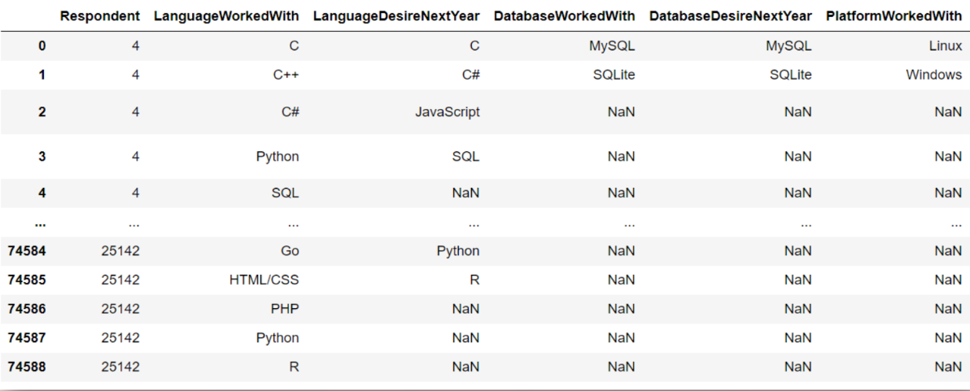
RESULTS

Slide 7
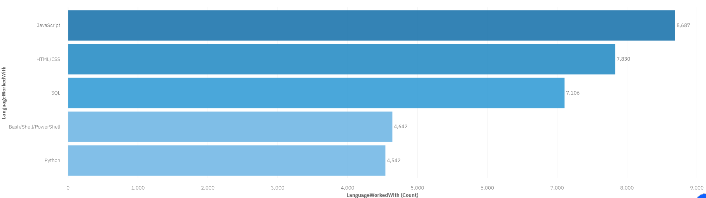
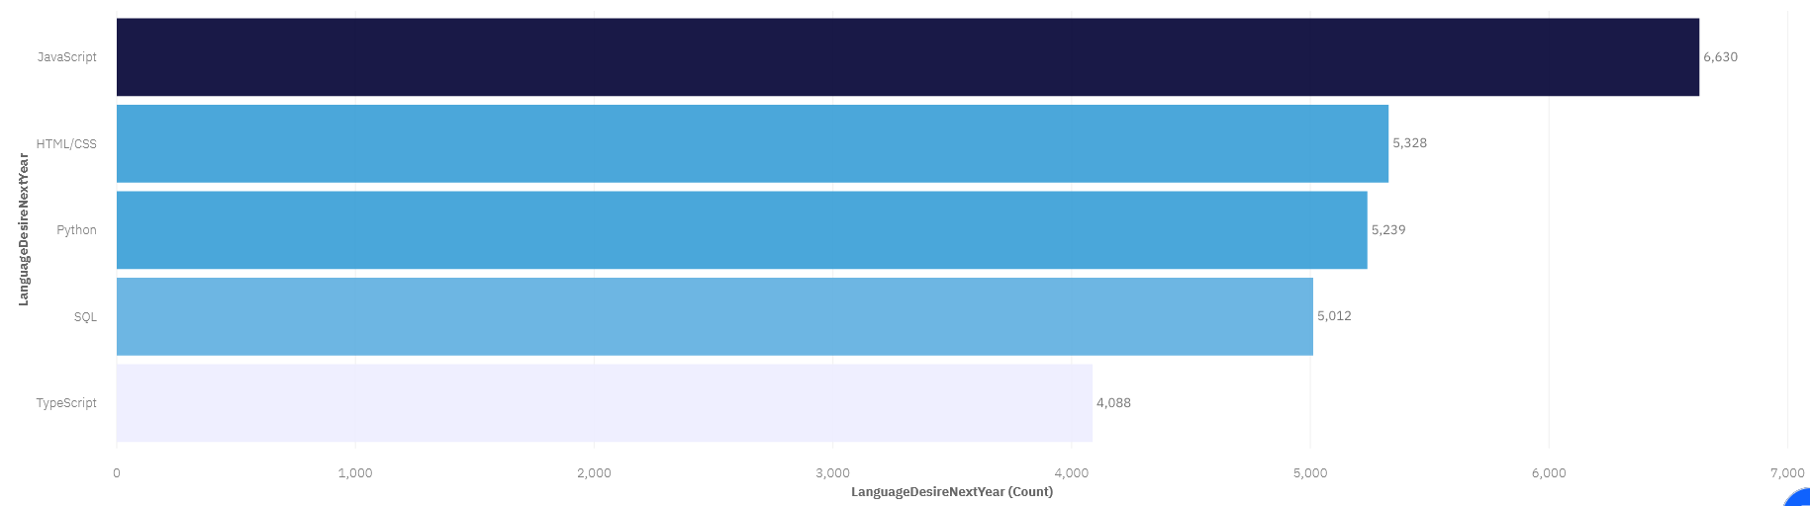
PROGRAMMING LANGUAGE TRENDS
Current Year
Next Year
<Bar chart of top 5 programming languages for the current year goes here.>
< Bar chart of top 5 programming languages for the next year goes here.>

Slide 8
PROGRAMMING LANGUAGE TRENDS - FINDINGS & IMPLICATIONS
Findings
Javascript top language currently used
Javascript is over 2x more used that the #4 language, Bash
Javascript is also the most desired language for next year
Implications
Around 2000 less people want to learn Javascript next year so its demand is decreasing
Python is currently 5th most used but 3rd most desired so an increase in Python users is expected
Go & Kotlin are both top-10 most desired for next year but not currently in the top-10 so more users are to be expected

Slide 9
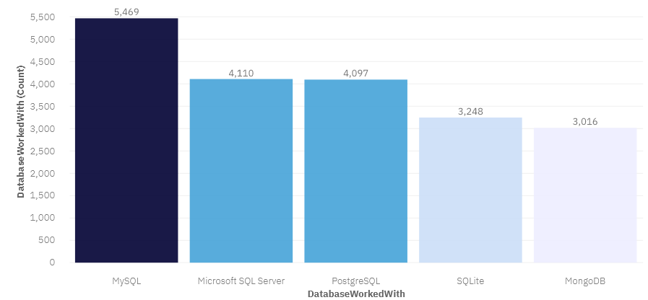
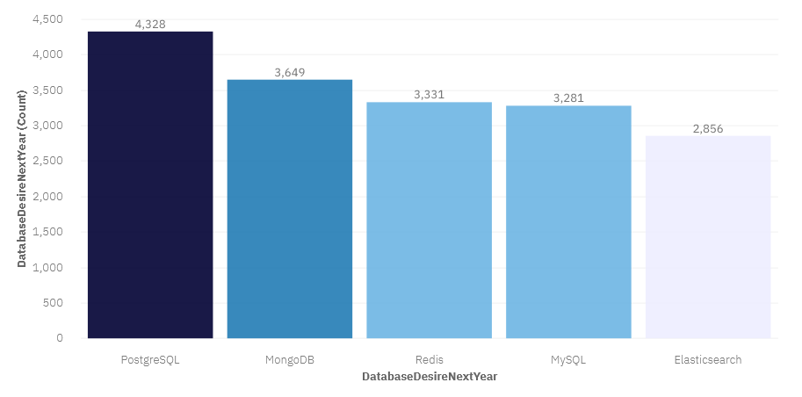
DATABASE TRENDS
Current Year
Next Year
< Bar chart of top 5 databases for the current year goes here >
< Bar chart of top 5 databases for the next year goes here.>

Slide 10
DATABASE TRENDS - FINDINGS & IMPLICATIONS
Findings
PostgreSQL is the most desired database for the future
MySQL is currently the most used
Elastisearch is currently 7th most used but is 5th in future desire
Implications
Oracle is currently 8th in usage but is not top-10 for the future, where DynamoDB enters at 10th
MongoDB is the 2nd most desired database but is 5th currently used, a large shift towards that DB is expected
Similarly, Redis is also expected to move up in usage as it is the 3rd most desired but 6th most used

Slide 11

DASHBOARD
https://dataplatform.cloud.ibm.com/dashboards/d146624e-1ac8-44e1-b27c-1ff0eeddb59c/view/5a61e716379c2cdf12cad4e4079e7f0674307108b7bb875783d77b495c672497a93f1294c82d43088f445032a6ea150fcf

Slide 12
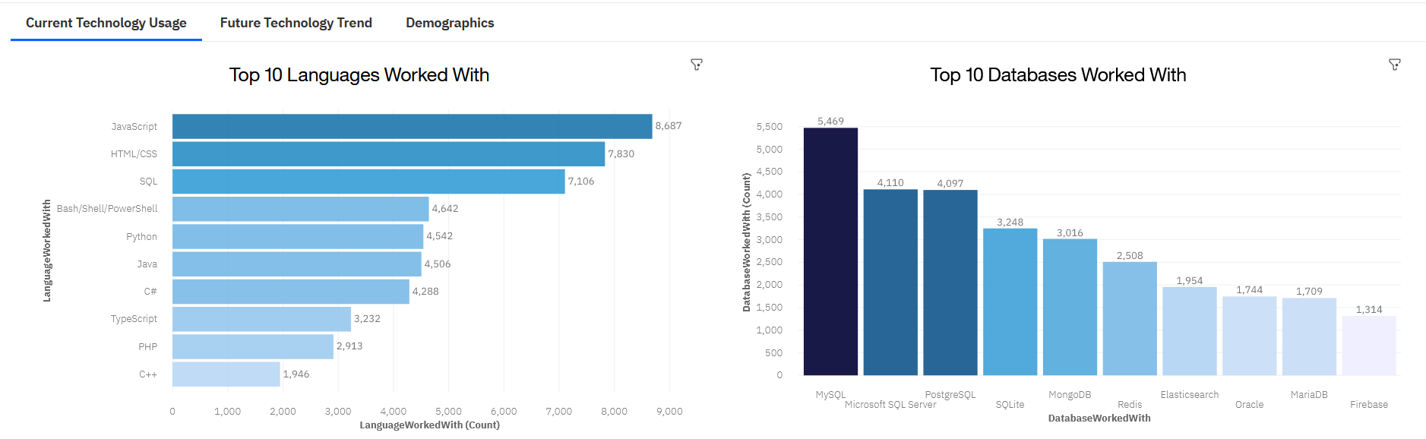
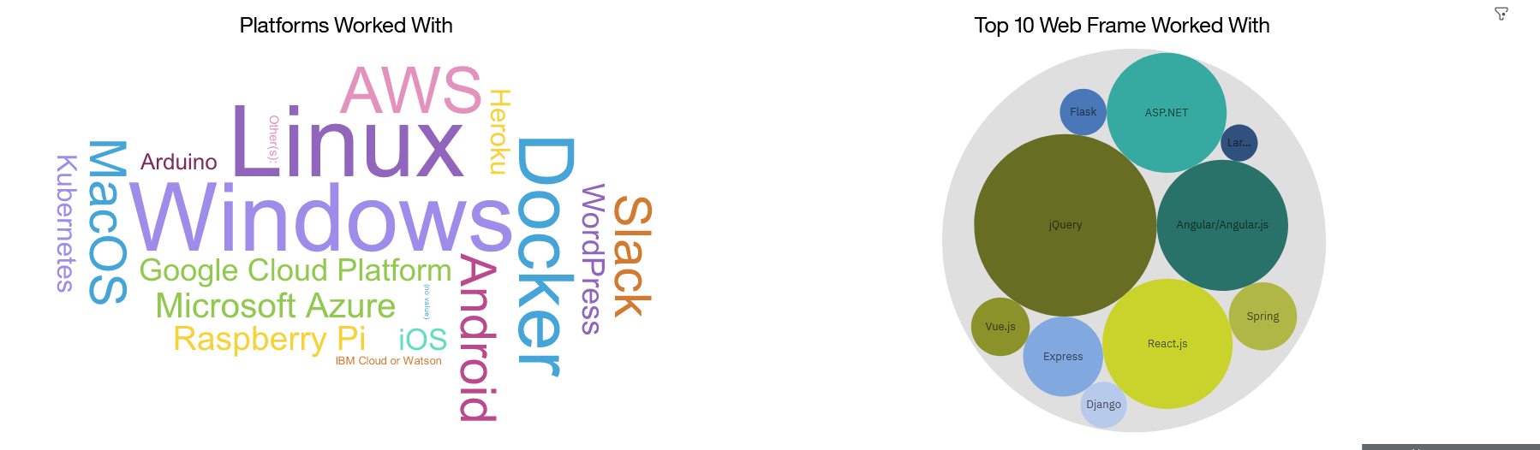
DASHBOARD TAB 1

Slide 13
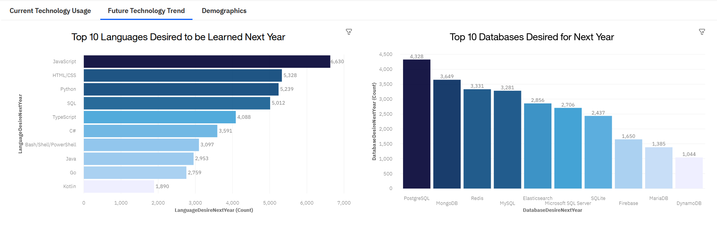
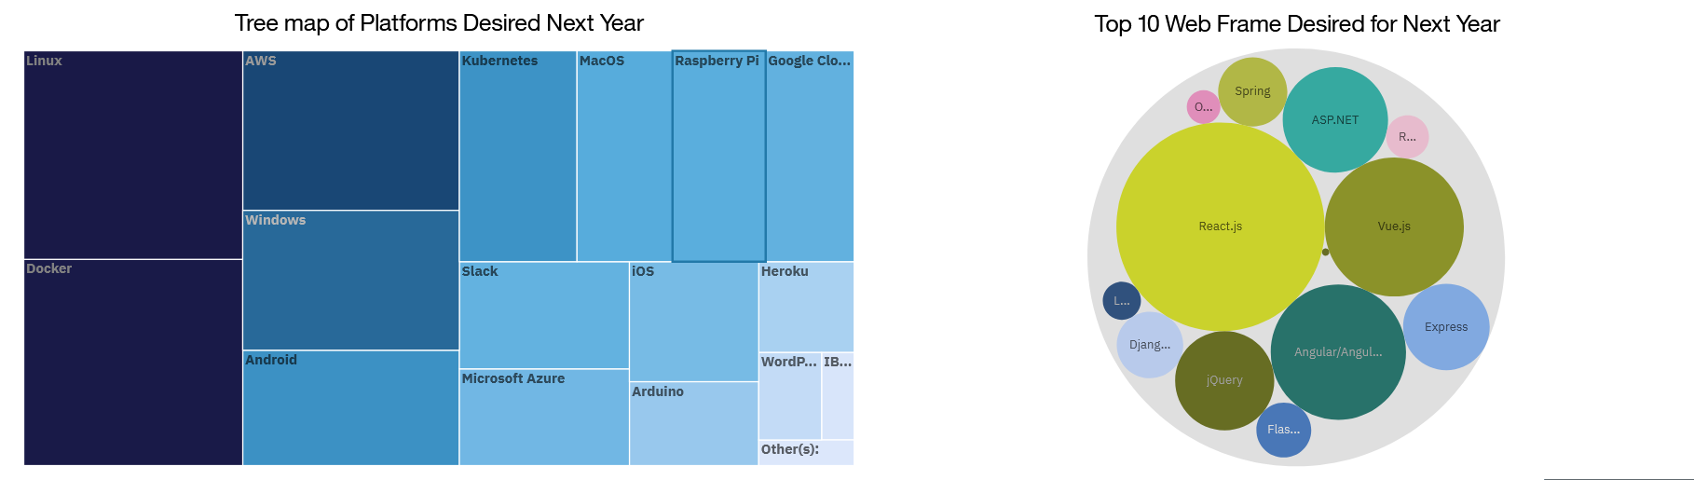
DASHBOARD TAB 2

Slide 14
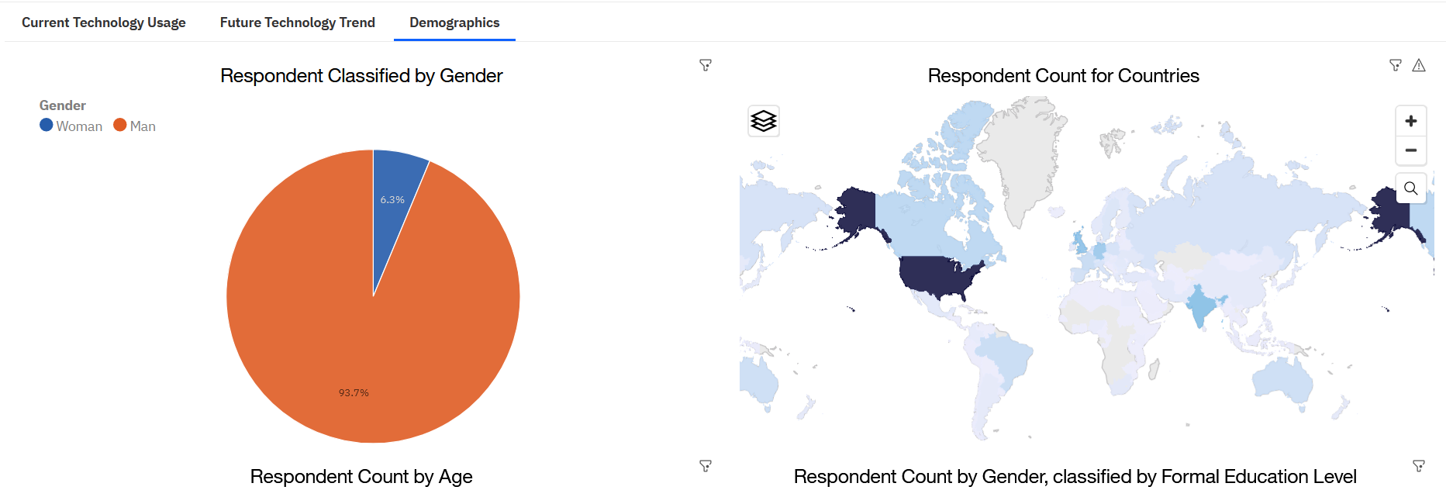
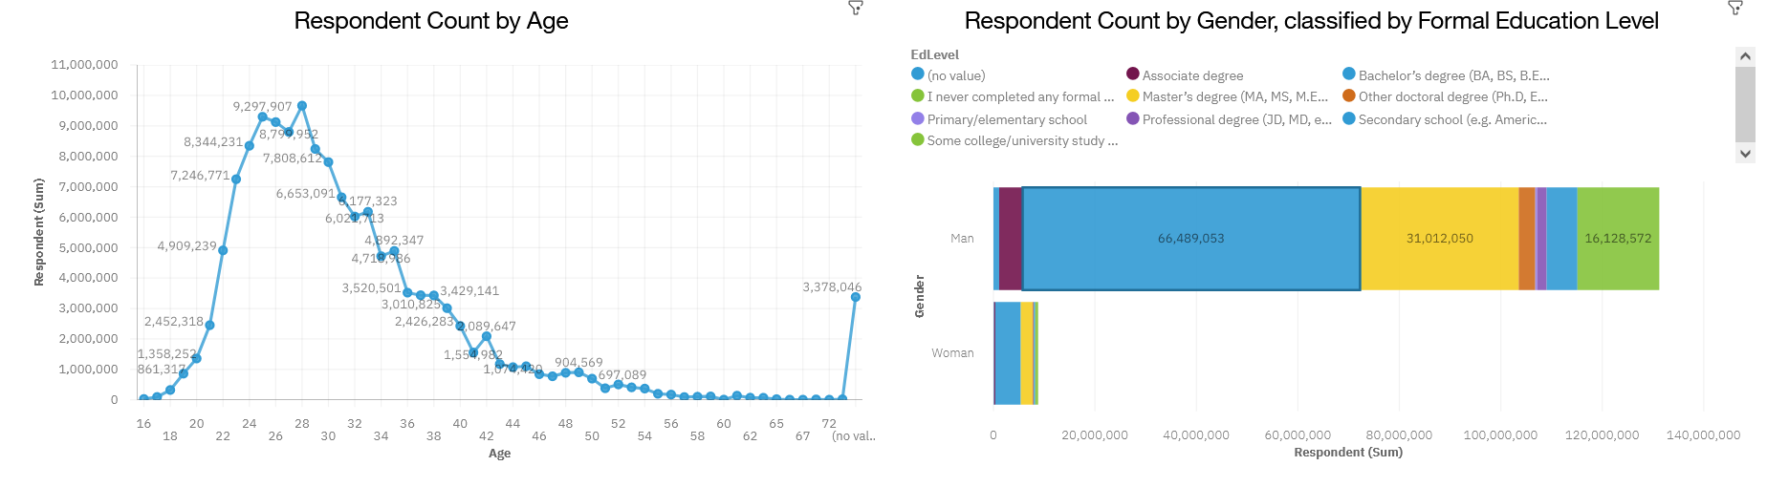
DASHBOARD TAB 3

Slide 15
DISCUSSION
Current technology trends vs upcoming trends
Gender gap
Age and Education discrimination
Lack of developers/programmers in developing nations
Retraining and reskilling workers

Slide 16
OVERALL FINDINGS & IMPLICATIONS
Findings
A small amount of countries control most of the tech workers e.g. USA
Significant gender gap exists, with few female workers
Trends in technology are constantly shifting
Implications
Both workers and companies need to be flexible to adapted to ever evolving tech trends
The tech lag in developing countries will increase unless dealt with
Significant steps are required to encourage females to enter the tech sector

Slide 17

CONCLUSION
Technology trends in languages, databases, platforms, and web frames
Demographic trends e.g. gender, age
Future trends
Actions to be taken

Slide 18
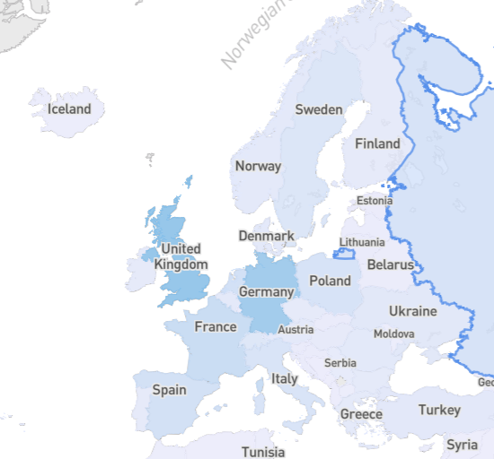
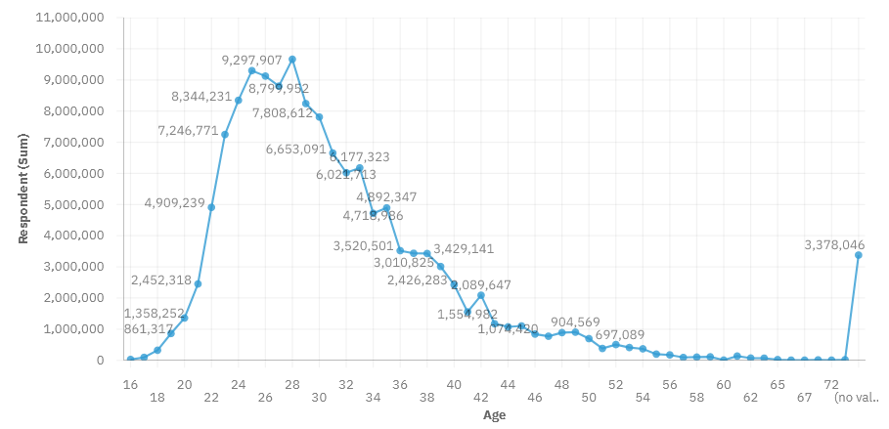
APPENDIX
European Respondent Count
Respondent Count By Age

Slide 19
GITHUB JOB POSTINGS

Slide 20
POPULAR LANGUAGES

